Slide 1
Chapter 11
INDIA AND ECONOMIC PLANNING

Slide 2
Economic planning is the preparation to achieve the economic objectives of the society, using the available resources within specific period of time . Economic planning plays a significant role in accelerating economic growth.

Slide 3
Milestones in Economic Planning
The Karachi Conference ( 1931) of the Indian National Congress was discussed how to overcome the British exploitation and stunted development .
In 1938, National Planning Committee was formed under the leadership of Jawaharlal Nehru.
Theb'Bombay Plan'(1944) prepared by a group of industrialists in Bombay for the economic development of India.
The 'Peoples Plan‘ prepared by the social activist, M.N Roy
The first industrial policy (1948) formulated in independent India strengthened economic development through planning.
The 'Father of Indian planning, M.Visvesvaraia, who authored the famous 'Planned Economy for India' in 1934 gave clear direction to economic planning.
The Indian Cabinet which met in 15th March 1950 passed a resolution to establish the Planning Commission of India.

Slide 4
Objectives of Economic planning in India.

Slide 5
Growth
Economic growth indicates the increase in output of goods and services produced in the country.
Increase in output in agriculture and industry, improvement in transport and communication facilities, increase in hospitals, educational institutions, commercial establishments, energy production, export etc contribute to economic growth.

Slide 6
Modernisation
Developments in machinery and technology have led to increase in productivity and simplification of manual labour.
Modernisation is making use of the latest technology.
Modernisation has improved the pace of travel and movement of goods. It has brought economic progress and saving of time.
Modernisation is not only using latest technology but also making a change in the perception of the society.
Modernisation involves protection of women's rights, social security, and openness to social changes.

Slide 7
Self-reliance
The aim of slef reliance is to attain self - sufficiency in agriculutral, industrial and service sectros using the available resoruces and to avoid foreign dependence.
Self reliance in the development of basic industries and energy will help the economic growth of the nation.

Slide 8
Equity
The objective of equity will be attained when all citizens receive basic necessities of life such as food, clothing, shelter, education, drinking water, health protection and righteous distribution of wealth

Slide 9
The Planning Commission and five year Plans
The Planning Commission is chaired by the prime minister who will be assisted by a full time vice chairman and members appointed by the cabinet.
Planning was adopted from Soviet Union.
Planning Commission visualized projects with a five year plan perspective. The aim of the Five Year Plans was to identify and prioritise certain sectors to attain the given targets.

Slide 10
Five Year Plan Period Objective
First Five Year Plan 1951-56 Overall development of agriculture
Second Five Year Plan 1956-61 Industrial development
Third Five Year Plan 1961-66 Self sufficiency in food , self sufficiency in economy
Fourth Five Year Plan 1969-74 Self-reliance and sustained growth
Fifth Five Year Plan 1974-79 Removal of poverty
Sixth Five Year Plan 1980-85 Improvement in infrastructure in agriculture and industry.

Slide 11
Seventh Five Year Plan 1985-90 Modernisation and increase in employment opportunities.
Eighth Five Year Plan 1992-97 Human resource development
Ninth Five Year Plan 1997-02 Rural development and decentralized planning.
Tenth Five Year Plan 2002-07 Increase in investment.
Eleventh Five Year Plan 2007-12 Overall development of the people.
Twelfth Five Year Plan 2012-17 Sustainable development

Slide 12
Green Revolution
The completion of the first and second Five Year Plans could not solve India's food deficiency.
It led to an all out effort to achieve self sufficiency in food and progress in agriculture.
There occurred a quantum jump in food output and a transformation in agriculture in two stages ( 1960-70 and 1970- 80) known as 'Green Revolution' .

Slide 13
Green Revolution was made possible through the use of high yielding seeds, improved irrigation, fertilizers, insecticides and agriculture finance at low interest rate.
The increased food output, especially in wheat and rice ended our dependence on foreigners and achieved self sufficiency.

Slide 14
Along with Green Revolution, India succeeded in increasing milk and milk products through ' White Revolution' and progress in fisheries sector through ' Blue Revolution'.

Slide 15
Decentralised Planning
The 73rd and 74thConstitutional Amendments were passed by the Parliament in 1992 and it led to the establishment of Panchayati Raj and Nagarpalika institutions in India .
A new threetier system of Grama Panchayat, Block Panchayat and District Panchayat started functioning in India.
This was the beginning of decentralized planning in India
The new system enabled the three tier panchayats to make use their authority and economic resources for local development.

Slide 16
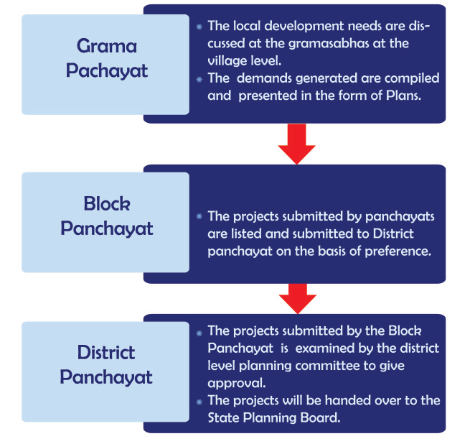

Slide 17
National Institution for Transforming India('NITI Aayog')
The NITI- Ayog came into being on 1st January, 2015instead of Planning commission.
The Chairman of the NITI Aayog is the Prime Minister.
The governing council consists of all state Chief Ministers, Lieutenant Governors of union territories, and a Vice chairman nominated by the Prime Minister.
In addition to full members, there are two part-time members and four ex-officio members and a chief executive officer .
The temporary members are selected from the leading universities and research institutions. The Prime Minister deputes four cabinet ministers as ex-officio members. The chief executive officer is appointed by the Prime Minister.

Slide 18
Aims of NITI Aayog
To bring down government participation in industrial and service sectors.
To improve agriculture production by practicing mixed farming.
To utilize the services of the dominant middle class for sustainable economic growth.
To make use of the services of non-resident Indians for economic and lenchnological growth.
To convert the cities into secure living centres using modern technology.
To equip the nation to face global transformation and market forces.

